Slide 1
深度學習 Pytorch手把手實作 影像分割
義隆電子 人工智慧研發部 黃志勝

Slide 2
Introduction
Brief Introduction
What is image segmentation?
Image segmentation architectures.
Hand-by-hand pytorch implementation.

Slide 3
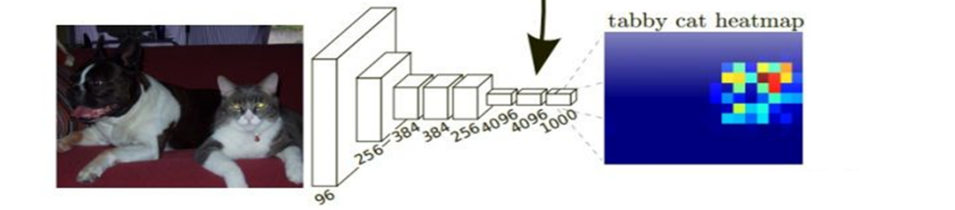
Deep Learning: Feature Extractor
Feature map可以做什麼?
這張圖是貓還是夠 (Classification)
框出圖片內有貓和狗的位置 (Object detection)
從框出的物件(貓和狗)中的描繪出實際物件的輪廓 (Instance Segmentation)
把圖片描繪出物件(貓和狗)的輪廓 (Semantic Segmentation)
h
Feature Map
w
1000 channel

Slide 4
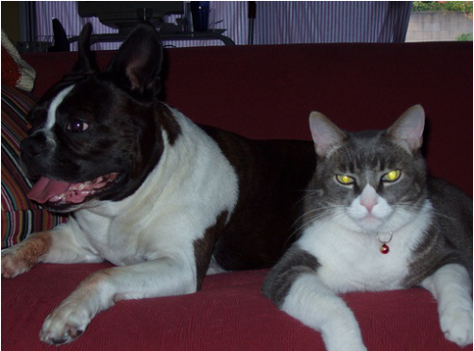

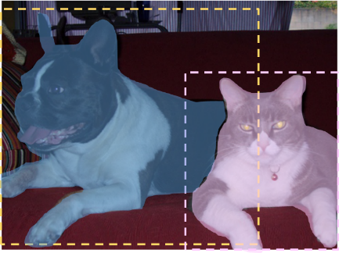
What is image segmentation?
This is the process of dividing an image into multiple segments.
Every pixel in the image is associated with an object type.
Semantic Segmentation
Instance Segmentation
pixel-by-pixel
藍色Mask是狗
紅色Mask是貓
橘色Mask是沙發
綠色是Background
Object detection後的框框內那些pixel是實際的物件。

Slide 5
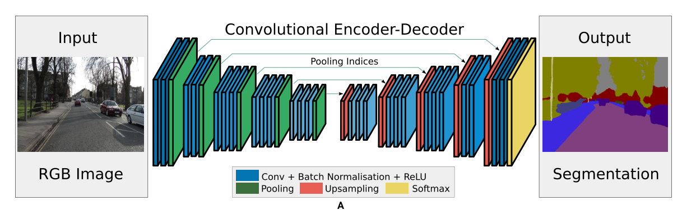
Image segmentation architectures
可原圖大小去訓練和inference:
缺點:計算資源需求大，內存要很夠。
優點: 結果較為準確。
可原圖大小(或resize到固定大小)去訓練，但結果只從1/8大小的結果輸出:
缺點:結果較差。
優點: 快速。

Slide 6
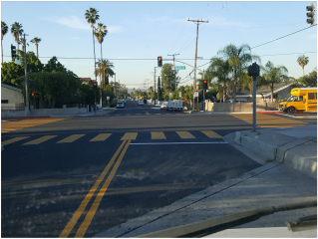
Image segmentation architectures
CNN
燈桿
車輛
天空
路

Slide 7
Semantic Segmentation
Pixel-level
Classification
…
…
…
…
…
…
…
1/4
scale
1/16
scale
1/8
scale
Input Image
1/2
scale
1/8
scale
1/4
scale
1/2
scale
1
scale
Encoder
Decoder

Slide 8
Semantic Segmentation
Pixel-level
Classification
…
…
…
…
…
…
Bilinear upsample
X2
1/4
scale
1/16
scale
1/8
scale
Input Image
1/2
scale
1/8
scale
1/4
scale
1/2
scale
1
scale
Encoder
Decoder

Slide 9
Semantic Segmentation
Pixel-level
Classification
…
Bilinear upsample
X4
…
…
…
…
1/4
scale
1/16
scale
1/8
scale
Input Image
1/2
scale
1/8
scale
1/4
scale
1
scale
Encoder
Decoder

Slide 10
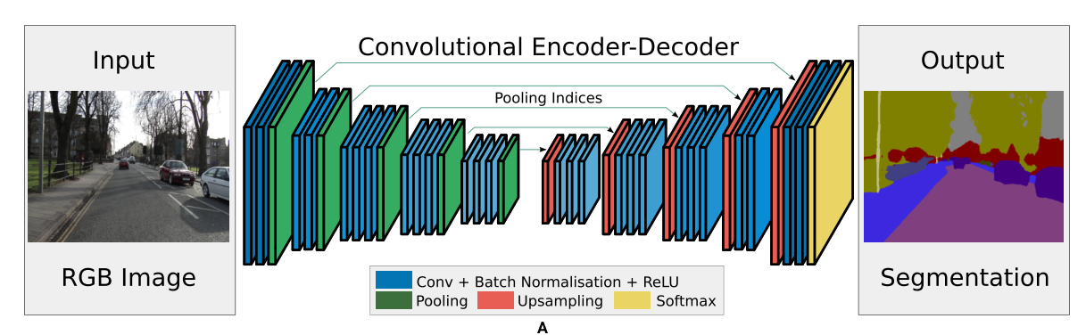
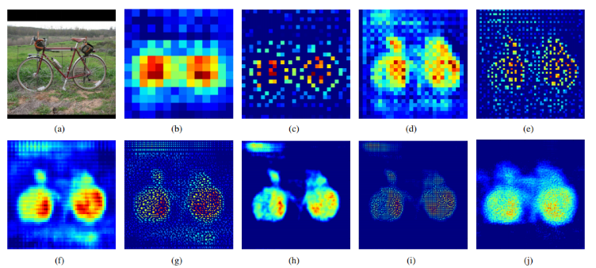
Semantic Segmentation
14*14
28*28
56*56
112*112
224*224

Slide 11
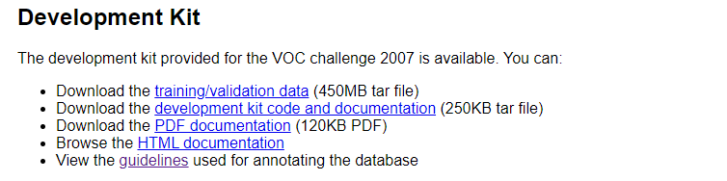
Hand-by-hand pytorch implementation.
Dataset: http://host.robots.ox.ac.uk/pascal/VOC/voc2007/
Download link: http://host.robots.ox.ac.uk/pascal/VOC/voc2007/VOCtrainval_06-Nov-2007.tar

Slide 12
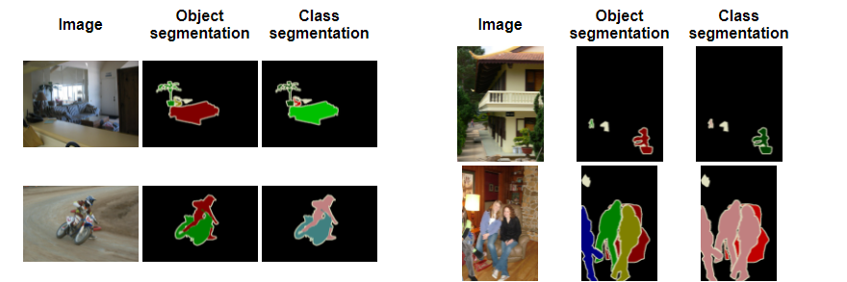
Dataset (VOC 2007)
the class segmentation (1=aeroplane, 2=bicycle, 3=bird, 4=boat, 5=bottle, 6=bus, 7=car , 8=cat, 9=chair, 10=cow, 11=diningtable, 12=dog, 13=horse, 14=motorbike, 15=person, 16=potted plant, 17=sheep, 18=sofa, 19=train, 20=tv/monitor)
Index 0 corresponds to background and index 255 corresponds to 'void' or unlabeled.
http://host.robots.ox.ac.uk/pascal/VOC/voc2007/segexamples/index.html

Slide 13
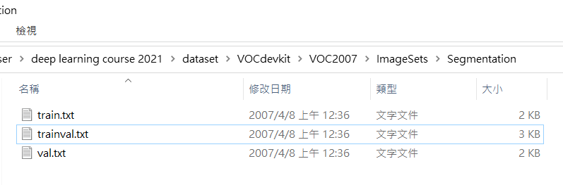
Dataset (VOC 2007)

Slide 14
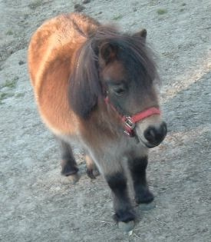

UNet Structure
In my example code, I build a Unet-like model for training/evaluating.
…
Conv. 3x3
(stride=1)
Conv. 3x3
(stride=2)
Upsample
Concat.

Slide 15
Hand-by-hand pytorch implementation.
Example: 10_pytorch_SemanticSegmentation_VOC2007.ipynb

